Slide 1
JSP Tag Libraries Tag Libraries JSTL The “Classic” Custom Tag Event Model Custom Tag #JSTL #CustomTag #Dynamic

Slide 2
Review
JSP Standard Actions
jsp:method attribute
Java Beans
jsp:useBean, jsp:setPropety, jsp:getProperty
Scopes: page, request, session, application
Dispatching Mechanisms
jsp:include, jsp:forward, jsp:param
Expression Language – EL
${EL Expression}
Operators, Implicit Objects, Scope Variables
Functions
Coercions

Slide 3
Objectives
How to remove all java code in JSP (View)? Complete the MVC 2 Design Pattern with View
JSTL
How to build the data grid tag library using in JSP?
Tag Libraries
Model
Classical, Simple, and Handles
How to implement the custom Tag Lib and use it in JSP

Slide 4
Objectives
Web based App - PBL
Web
Day 1, 2, 3, 4, 5, 6 – Login
Servlet, JDBC
Day 7, 8, 9 – Search
Break Down
Day 10, 11 – MVC2
JSP
Day 12, 13, 14, 15 – CUD, Shopping Carts
Sessions
Day 16, 17 – Login
JavaBeans
Day 18, 19, 20 – CRUD
MVC 2 Complete - JSTL - Taglib
Day 21, 22, 23 – Filter
MVC2 Using Filter as Controller

Slide 5
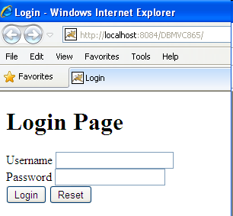
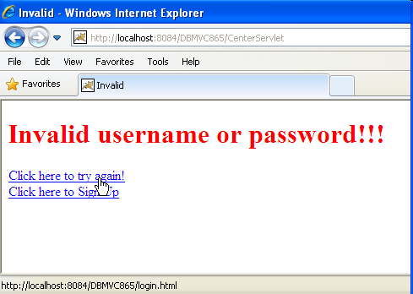
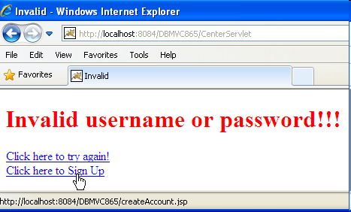
Complete MVC 2 Requirements
Complete the MVC 2 with CRUD Web Application in previous topic

Slide 6
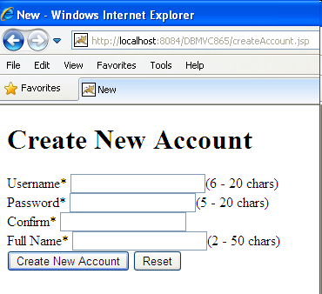
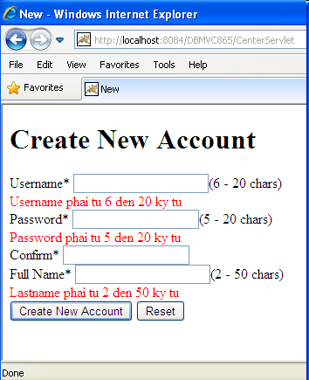
Complete MVC 2 Requirements

Slide 7
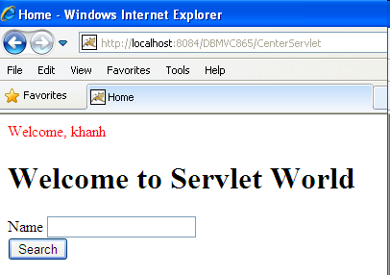
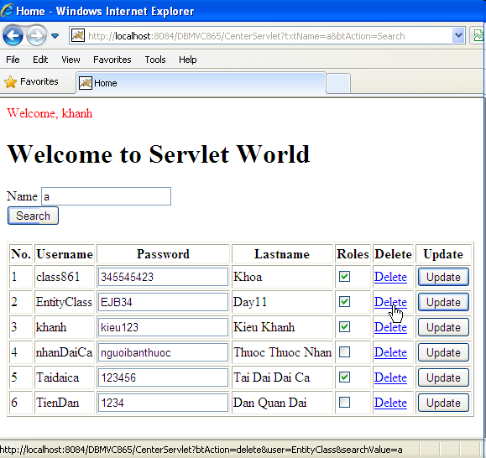
Complete MVC 2 Requirements

Slide 8
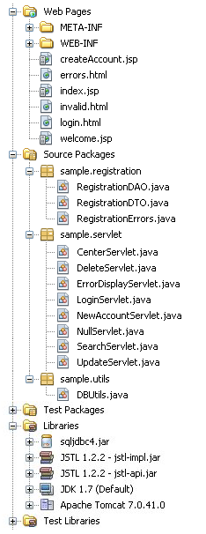
Complete MVC 2 Expectation

Slide 9
JSTL JSP Standard Tag Library
Is a new component being offered by the Sun for JSP programming.
A library of predefined tags (by Sun) that provides a set of reusable standard tags that works in the similar manner everywhere
Allows programming using tags rather than scriptlet code JSTL has reusable standard set of tags.
Provides the user with a script-free environment
Are easier for non-programmers & inexperienced programmers
Disadvantages
It adds processing overhead to the server. The tag libraries are compiled into a servlet, which is then executed by the servlet container. The server is added with much more code by the JSTL.
JSTL is also less powerful than the scriptlets as embedded java codes can do everything in JSP pages

Slide 10
JSTL Type of Tag Library
JSP Standard Tag Library (JSTL)
Core Tag Library
EL Functions
SQL Tag Library
I18N & Formatting Tag Library
XML Tag Library

Slide 11
JSTL Core Tag Library
The library contains the tags for looping, expression evaluation, handle flow controls, and basic input and output.
It can be declared by
<%@ taglib prefix=“c” uri= “http://java.sun.com/jsp/jstl/core” %>
General Purpose Tags
Are used to set, remove and display variable values that are created within a JSP page.
The core tag library contains tags for getting, setting and displaying attribute values.

Slide 12
JSTL Core Tag Library – General Purposes
Tags | Descriptions
<c:set> | - <c:set var=“varName” value=“value/exp” scope=“page|request|session|application” /> Assigns or update a value to a variable in scope Similar to set attribute to some scope using setAttribute() method Ex: <c:set var=”simple” value=”${2+1}” scope=“session”/> Similar to <% session.setAttribute(“simple”, new Integer(2+1)) %> The var of set can be accessed using ${varName} on page, or ${scope.varName} on page or other pages, or <%= scope.getAttribute(“varName”) %>
<c:remove> | - <c:remove var=“varName” scope=“page|request|session|application” /> Remove a scope variable. This is an empty tag Similar to remove attribute from some scope using removeAttribute() method Ex : <c:remove var=”simple” scope=”session”/> Similar to <% session.removeAttribute(”simple”) %>

Slide 13
JSTL Core Tag Library – General Purposes
Tags | Descriptions
<c:out> | - <c:out value=“value|expression” escapeXml=“true|false” default=“defaultValue” /> Evaluate an expression & store the result in the current JspWrite object Default value if the resulting value is null Similar to print out the data using out object in JSP Implicit Object Ex: <c:out value=”${simple}”/> similar to <%= pageContext.getAttribute(simple) %>
<c:catch> | - <c:catch [var=”varName”]>…</c:catch> - Provides an exception handling functionality, such as try-catch, inside JSP pages without using scriptlets

Slide 14
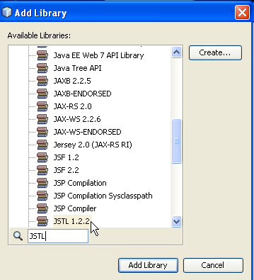
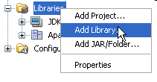
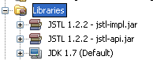
JSTL Requirement
Required Library for JSTL
JSTL 1.2.2 (jstl-impl.jar, jstl-api.jar)
Choose JSTL 1.2.2

Slide 15
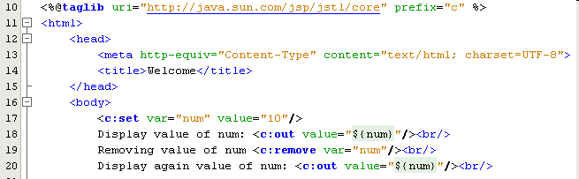
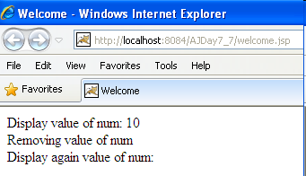
JSTL Core Tag Library – Example

Slide 16
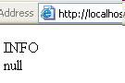
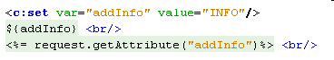
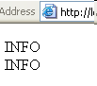
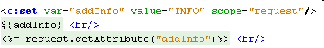
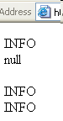
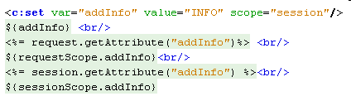
JSTL Core Tag Library – Example

Slide 17
JSTL Core Tag Library – Decision Making
Support conditions in a JSP page
Are necessary as the contents or the output of the JSP page is often conditional based on the value of the dynamic application data
Tags | Descriptions
<c:if> | - <c:if test =“testcondition” var=“varName” scope=“page | request | session | application”>…</c:if> - Is used for conditional execution of the code - Is a container tag that allows the execution of the body if the test attribute evaluates to true
<c:choose> | <c:choose> <c:when test=”cond”>...</c:when> <c:otherwise>…</c:otherwise> </c:choose> - Is similar to the switch statement in Java (multiple conditions) - Performs conditional block execution (replace to c:if) - Multiple <c:when> tags can be embedded in a <c:choose> tag - If none of the conditions evaluates to true, then the body of <c:otherwise> tag is processed.

Slide 18
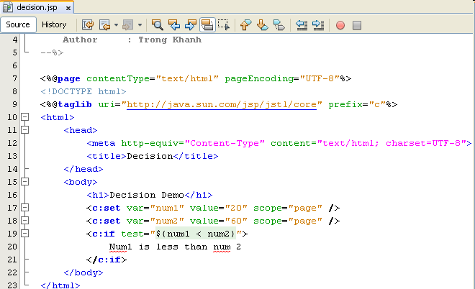
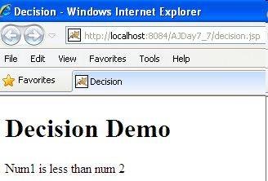
JSTL Core Tag Library – Example

Slide 19
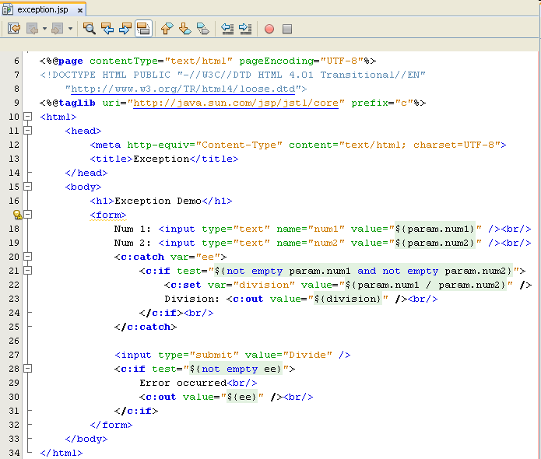
JSTL Core Tag Library – Example

Slide 20
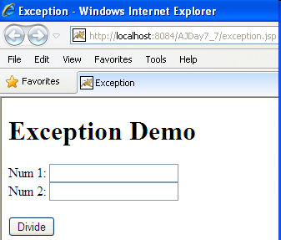
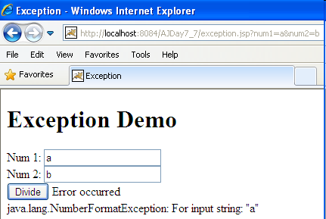
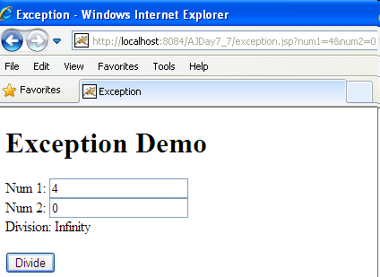
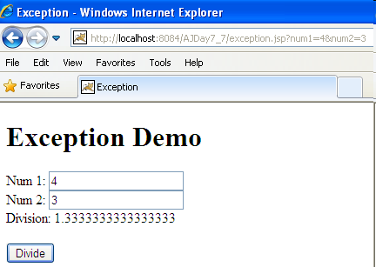
JSTL Core Tag Library – Example

Slide 21
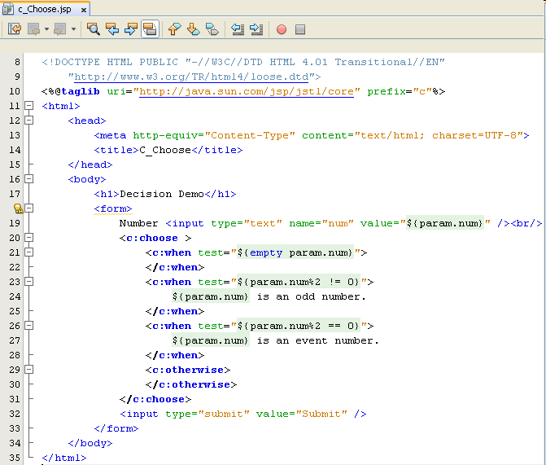
JSTL Core Tag Library – Example

Slide 22
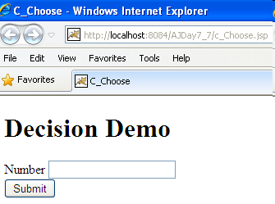
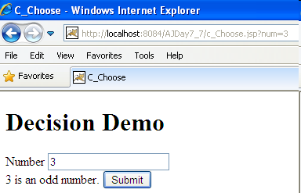
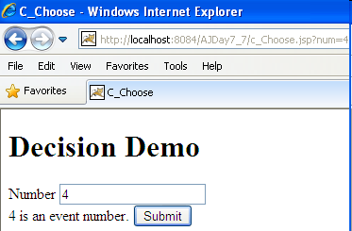
JSTL Core Tag Library – Example

Slide 23
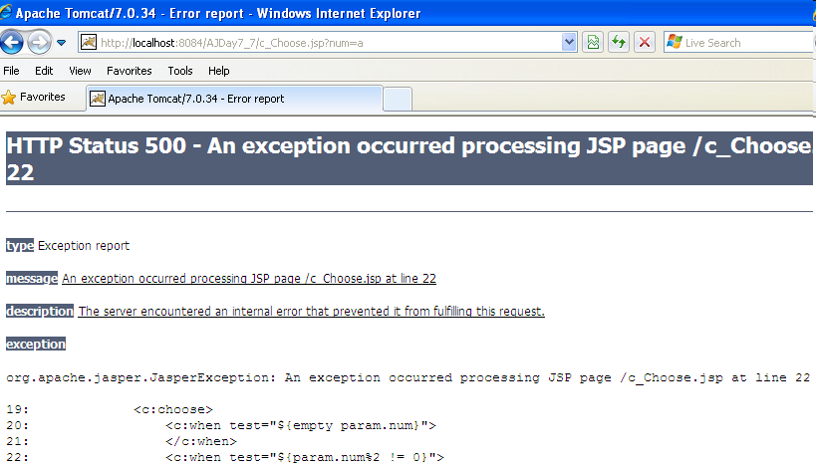
JSTL Core Tag Library – Example

Slide 24
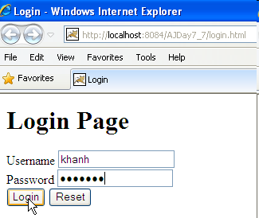
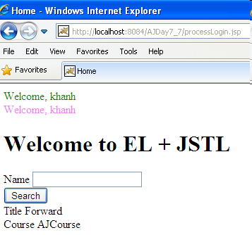
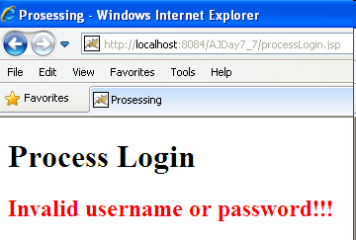
JSTL Example
Improve the 6th topic using EL combining with JSTL

Slide 25
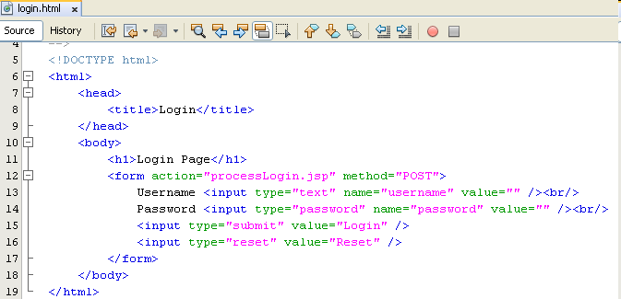
JSTL Example

Slide 26
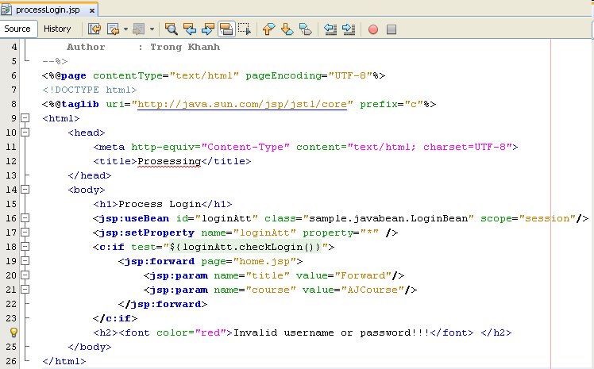
JSTL Example

Slide 27
JSTL Core Tag Library – Iterations
Is required for performing looping function
The object can be retrieved from a collection in the JavaBeans component and assigned to a scripting variable by using iteration tags
Tags | Descriptions
<c:forEach> | - <c:forEach var=“varName” items=“collection” begin=“begin” end=“end” step=“step” varStatus=“internalLoopobject”>…</c:forEach> - Is used repeat the body content over a collection of objects Will continue for a number of times specified by the user in the code varStatus’s methods: count (int), current (obj), index (int)
<c:forTokens> | - <c:forTokens items=“stringofToken” delims=“delimiters” var=“varName” >...</c:forTokens> - Is used to iterate over a collection of tokens separated by user-specified delimiters - It is a container tag

Slide 28
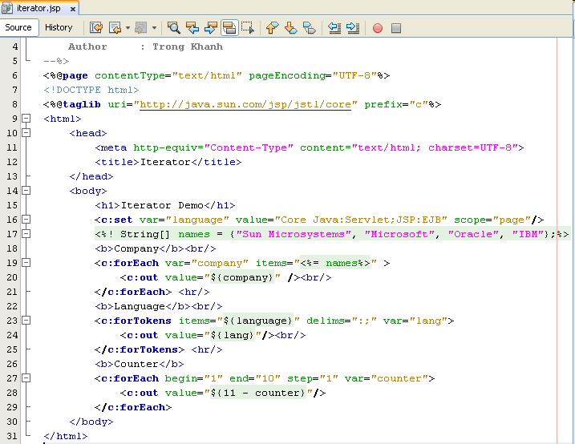
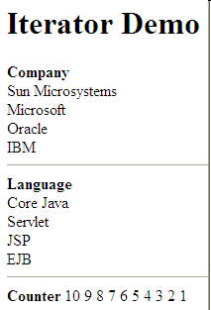
JSTL Core Tag Library – Example

Slide 29
JSTL Core Tag Library – URL-Related Actions
Are used to import resources from a given URL, re-encode URLs, redirect to URLs, as well as pass additional request parameters where necessary
Tags | Descriptions
<c:import> | - <c:import url=“url of resource import” var=“varName” scope=“scopeName”>…</c:import> Imports the content of a URL-based resource. Action main include nested <c:param> tags to specify the query string (unless the varReader attribute is specified). Ex: <c:import var=“xml” url=“WEB-INF/abc.xml”/>
<c:url> | - <c:url var=“varName” value=”path” scope=”scopeName” >...</c:url> Builds a URL with the proper rewriting rules applied (only relative URLs are rewritten). Action may include nested <c:param> tags to specify the query string Ex: <c:url var=“addr” value=“ProcessServlet”/> <a href=“${addr}”>click here</a>

Slide 30
JSTL Core Tag Library – URL-Related Actions
Tags | Descriptions
<c:redirect> | <c:redirect url=“url path”>…</c:redirect> Sends the client a response to redirect to the specified URL. This action willabort processing of the current page. Action may include nested <c:param> tags to specify the query string. Ex: <c:redirect url=“abc.jsp”/>
<c:param> | <c:param name=“nameOfQuery” value=”ValueOfParameter”>...</c:param> Adds request parameters to a URL. This action can only be nested within <c:import>, <c:url>, or <c:redirect>

Slide 31
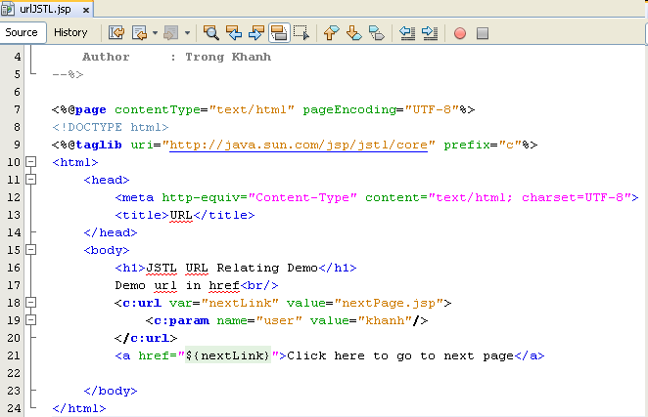
JSTL Core Tag Library – URL-Related Actions
Same as “nextPage.jsp?user=khanh

Slide 32
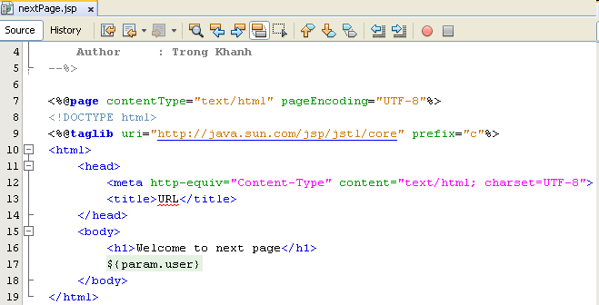
JSTL Core Tag Library – URL-Related Actions

Slide 33
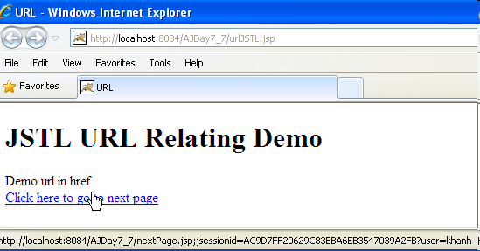
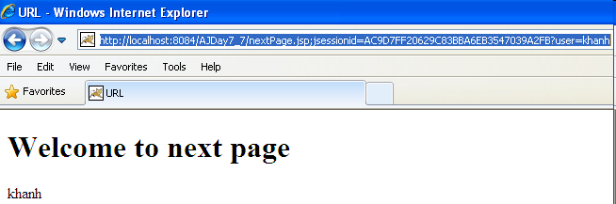
JSTL Core Tag Library – URL-Related Actions

Slide 34
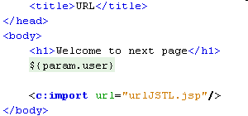
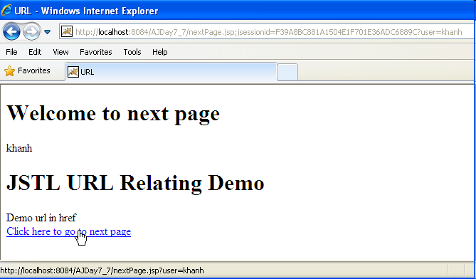
JSTL Core Tag Library – URL-Related Actions

Slide 35
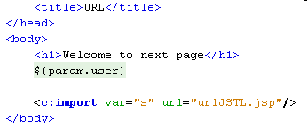
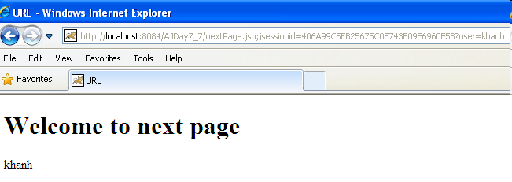
JSTL Core Tag Library – URL-Related Actions

Slide 36
JSTL Core Tag Library – Summary
Core Tag Library
General Purpose Tags
Decision Making Tags
Iteration Tags
set
remove
out
if
choose
forEach
forTokens
URL Related Tags
import
url
redirect
param

Slide 37
Complete MVC 2 Requirements
Complete the MVC 2 with CRUD Web Application in previous topic

Slide 38
Complete MVC 2 Requirements

Slide 39
Complete MVC 2 Requirements

Slide 40
JSTL Functions Tag Libraries
The library contains tags, which provides the utility functions in process on jsp page combining jstl
All functions treat null Strings as empty Strings
It can be declared by
<%@ taglib prefix=“fn” uri=”http://java.sun.com/jsp/jstl/functions” %>
Some functions
fn:length
fn:contains
fn:containsIgnoreCase
fn:indexOf
fn:split
fn:trim
fn:substring
…

Slide 41
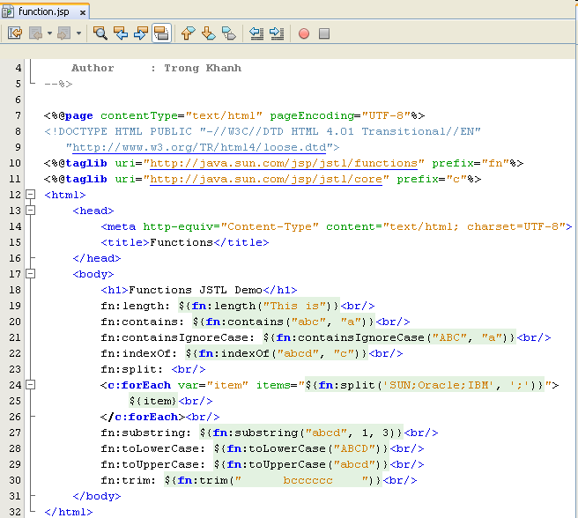
JSTL Functions Tag Libraries

Slide 42
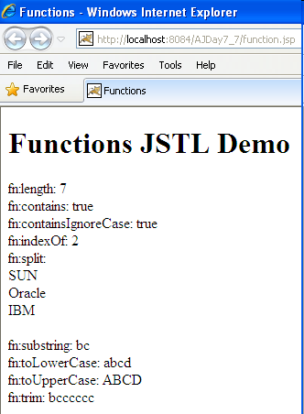
JSTL Functions Tag Libraries

Slide 43
JSTL SQL Tag Library
The library contains tags, which are used to access SQL databases, are used to perform the database related tasks, such as selection, insertion, deletion and modification without using java codes
It provides an interface for executing SQL queries on database through JSP.
It can be declared by
<%@ taglib prefix=“sql” uri=”http://java.sun.com/jsp/jstl/sql” %>
The “setDataSource” Tag
Is used to set a data source for the database.
Is an empty tag and allows the user to set data source information for the database
Syntax:
<sql:setDataSource dataSource=“datasource” | url=“jdbcurl” driver=“jdbcclassdriver” user=“username” password=“password” var=“varName” scope=“page | request | session | application” />
If the DataSource attribute is used, then url attribute cannot be used.

Slide 44
JSTL SQL Tag Library
The “query” Tag
Searches the database and returns a result set containing rows of data. (Passing database queries function)
The tag can either be an empty tag or a container tag.
The SELECT statement is used to select data from the table.
Syntax
<sql:query var=“varName” dataSource=“datasource” scope=“page | request | session | application”>
SQL Statement
<sql:param value=“value” />
</sql:query>
The “update” Tag
Executes the INSERT, UPDATE AND DELETE statements.
Zero is returned if no rows are affected by statements
Syntax
<sql:update var=“varName” dataSource=“datasource” scope=“page | request | session | application”>
SQL Statement
<sql:param value=“value” />
</sql:update>

Slide 45
JSTL SQL Tag Library
The var attribute of query Tag
Is javax.servlet.jsp.jstl.sql.Result interface
Methods
columnNames: Returns the names of the columns in the result
rowCount: Returns the number of rows in the cached ResultSet
rows: Returns the result of the query as an array of SortedMap objects
rowsByIndex: Returns the result of the query as an array of arrays
limitedByMaxRows: Returns true if the query was limited by a maximum row setting

Slide 46
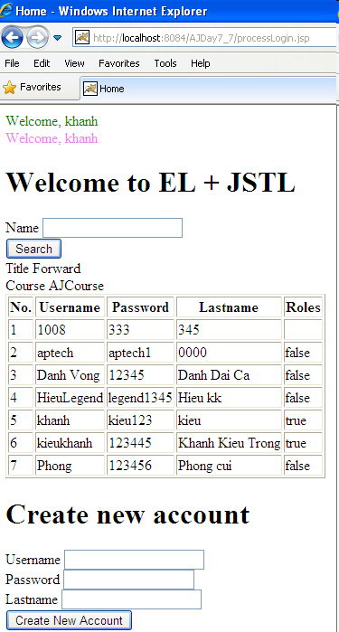
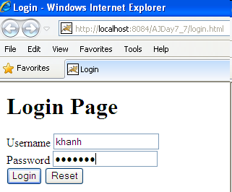

JSTL SQL Tag Library – Example

Slide 47
JSTL SQL Tag Library
The “transaction” Tag
Is used to established a transaction context for <sql:query> and <sql:update> tags.
The connection object is obtained from <sql:transaction> as this tag is responsible for managing access to the database.
Syntax
<sql:transaction dataSource=“datasource” isolation=“isolationLevel”>
<sql:update> or <sql:query> Statements
</sql:transaction>
The “param” Tag
Is used to set values for parameters markers (“?”) in SQL statements.
It acts as a sub tag for <sql:query> and <sql:update>
Syntax
<sql:param value=”value”/>

Slide 48
JSTL SQL Tag Library
SQL Tag Library
setDataSource
query
update
transaction
param

Slide 49

Build Library Tag Lib Library Requirements
Build the data grid tag library using in JSP as

Slide 50
Tag Libraries Tag Extension Mechanism
Enables creation of custom tags
Java code can be avoided using custom tags
Separates the work profiles of Web designers and developers (representation and business logic)
Custom tags can be reused
Written using XML syntax
Encapsulation
Components of custom tag
Tag Library Descriptor (TLD): an XML document contains information about the contents of a tag library.
Custom Action: a Java class implements the contents in the TLD
Web deployment descriptor: locate the custom tag library to use
A Tag is implemented through extending some interfaces of the javax.servlet.jsp.tagext package

Slide 51

Tag Libraries Tag Extension Mechanism

Slide 52
Tag Libraries Terminologies
Classic custom tag is defined by the classic tag handler class.
Simple custom tag is defined by the simple tag handler classes.
Basic tags
Generally do not contain any body. (Even if it contains body, the body is not processed by the tag.)
The tag handler class of the basic tag implements the Tag interface and extends the TagSupport class.
Iteration tags
Are valuated time and again.
Are generally empty tags.
The tag handler class for an iteration tags needs implementation of IterationTag interface that extends the Tag interface.
Complex tags
Support evaluation of the body content of the tag including other services provided in the basic tag or iteration tag.
Implement BodyTag interface and extend the BodyTagSupport class.

Slide 53

Tag Libraries Terminologies

Slide 54
Tag Libraries Custom Tags
Allow Java programmer to embed Java codes in JSP documents
Helps the developer reducing the overhead of writing the same business logic again for a particular action to be repeated in programs
Supporting the front end, developer need not bother about the complexity of the logic of a tag because the tag is created by a Java developer and the front end developer only imports it to the JSP page.
Provide a mechanism to reuse and encapsulate complex recurring code or tasks in JSP
Provide simplicity and reusability of Java code
Custom tag body can include static text, HTML, and JSP elements like scriptlets, between the start and the end tag

Slide 55
Tag Libraries The Custom Tag Development Process
There are 4 essential steps to writing a custom tag
Create a Tag Library Descriptor (.tld) – TLD file
Is an XML document that is used to validate the tags.
Contains the information on each tag available in the library
Provides the JSP engine with meta-information about the custom tag and about its implementation
Contains the list and description of all custom tags in the library
Usually locates at the tlds folder inside WEB-INF directory
Create a Tag Handler class in proper package with tld file.
Is a Java class that defines a tag described in the TLD file.
What a tag will implement depends on what methods can be called and what is required to be implemented.
These are of two types, classic and simple.
Provide details of where to find the TLD file in web.xml (option – required if the tld files don’t put at the WEB-INF/tlds directory)
Creating a JSP page that will access the custom tags: using a taglib directive in the page before any custom tag is used.

Slide 56
taglib uri declaration in
JSP page maps to <taglib-uri> in deployment descriptor.
JSP Document
<html>
<body>
<%@taglib uri="test_taglib" prefix="myTag"%>
<myTag:showDate/>
</body>
</html>
Web Deployment Descriptor
<web-app>
<taglib>
<taglib-uri> test_taglib </taglib-uri>
<taglib-location>
/WEB-INF/myown-taglib.tld
</taglib-location>
</taglib>
</web-app>
START HERE: tag used in JSP page.
Tag Library Descriptor
<taglib>
<tag>
<name>showDate</name>
<tagclass>examples.ShowDateTag</tagclass>
<bodycontent>EMPTY</bodycontent>
</tag>
</taglib>
<taglib-location> in
deployment descriptor maps to
the real tag library descriptor file.
Tag Handler Class
1000001000000010101010
0000101010100000010010
1000011111111000000000
1000001000000010101010
0000101010100000010010
1000011111111000000000
Finally:
<tag-class> in the TLD maps to a tag handler class.

Slide 57
Tag Libraries The TLD file
<?xml version="1.0" encoding="UTF-8"?>
<taglib version="2.0" xmlns="http://java.sun.com/xml/ns/j2ee" xmlns:xsi="http://www.w3.org/2001/XMLSchema-instance" xsi:schemaLocation="http://java.sun.com/xml/ns/j2ee web-jsptaglibrary_2_0.xsd">
<tlib-version>1.0</tlib-version>
<short-name>shortName-prefix</short-name>
<uri>/WEB-INF/tlds/CustomTag</uri>
<tag>
<name>tagName-method</name>
<tag-class>TagHandlerName</tag-class>
<body-content>JSP|EMPTY|scriptless|tagdependent</body-content>
<attribute>
<name>attributeName</name>
<required>false/true</required>
<rtexprvalue>false/true</rtexprvalue>
</attribute>
</tag>
/<taglib>

Slide 58
Tag Libraries Mapping TLD file in web.xml
<web-app>
…
<jsp-config>
<taglib>
<taglib-uri>tld file name</taglib-uri>
<taglib-location>tld location path</taglib-location>
</taglib>
</jsp-config>
…
</web-app>
Ex:
<taglib>
<taglib-uri>CustTags-taglib.tld</taglib-uri>
<taglib-location>/WEB-INF/classes/CustTags-taglib.tld</taglib-location>
</taglib>

Slide 59

Tag Libraries Hunting the Tag

Slide 60
Tag Libraries The Tag Libraries
Is a collection of custom tags
Allows the developer to write reusable code fragments, which assign functionality to tags
The reference to each tag is stored in the tag library
When a tag is used in a JSP page, the taglib directive must be imported as
<%@ taglib uri=“/WEB-INF/tlds/TagHandler” prefix=“u” %>
Locating TLD File: after iterating with the <@%taglib…> directive, traces the location of the tag library descriptor file (through URI) and subsequently to the location of the tag handle class
Associating URIs with TLD File Locations: The uri attribute is mapped to the .tld file by two methods
Implicit
By referring to the tag library descriptor from the expanded WEB-INF folder.
By referring to a JAR file containing a tag library.
Explicit: By defining reference to the tag library descriptor in the deployment descriptor, web.xml of the Web application

Slide 61
Tag Libraries The Tag Libraries
Tag Library Prefix
Distinguish these tags from one another, they are named uniquely by using prefix attributes in the taglib directive
Is used as a reference by the container to invoke its respective TLD file and tag handler class
The value of prefix and the sub element <short-name> inside the <taglib> within the TLD file should match
Notes:
The tld files can be mapped in implicit (e.g. they should be put at the WEB-INF/tlds)
The tld files can be packaged into a jar file, and the tld files within the jar file must have a path that begins /META-INF directory
The tld files must contain the optional <uri> element, which must match the uri of the taglib directive or the namespace value

Slide 62
The “Classic” Custom Tag Event Model Basics
Uses a tag handler class, which implements Tag, IterationTag and BodyTag interfaces or extends the classes TagSupport or BodyTagSupport
Interfaces/Classes | Descriptions
Tag | - Allows communication between a tag handler and the servlet of a JSP page. - Is particularly useful when a classic custom tag is without any body or even if it has body when it is not for manipulation
IterationTag | - Is used to by tag handlers that require executing the tag, time and again without manipulating its content. - Extends to the Tag interface
BodyTag | - The tag handler class of a tag which manipulates its body needs to implement - Extends to the IterationTag and in turn to the Tag interface.
TagSupport Class | - Acts as the base class for most tag handlers which support, empty tag, tag with attributes and a tag with body iterations. - Implements the Tag and IterationTag interfaces. Thus, it implements all the methods in these interfaces. - Contains methods such as, doStartTag(),doEndTag() and doAfterBody().
BodyTagSupport | - Can support tags that need to access and manipulate the body content of a tag. - Implements the BodyTag interface. - Extends the TagSupport class. - Contains the following methods: setBodyContent() and doInitBody().

Slide 63

The “Classic” Custom Tag Event Model Basics
Tag Interfaces and Classes in javax.servlet.jsp.tagext

Slide 64

The “Classic” Custom Tag Event Model Tag Interface

Slide 65
Tag Interface
Methods | Descriptions
doStartTag | - public int doStartTag() throws JSPException - Is invoked when a request is made to a tag or encountering the starting tag of the element - Returns the SKIP_BODY constant if there is no body to evaluate and returns the EVAL_BODY_INCLUDE constant if the body after evaluation needs to be sent to the output stream. - In case of the BodyTag interface, it can return EVAL_BODY_BUFFERED that the evaluated body is to be stored in a buffer temporarily.
doEndTag | - public int doEndTag() throws JSPException - Is invoked when the JSP page encounters the end tag. - Generally follows the execution of the doStartTag() if the tag is empty. - Returns the SKIP_PAGE constant if there is no need to evaluate the rest of the page and returns EVAL_PAGE constant if the rest of the page needs to be evaluated.
setParent | - public void setParent(Tag t) - Sets the current nesting or parent tag of a nested tag. - Is invoked prior to doStartTag()
getParent | - public Tag getParent() - Returns the current parent tag
setPageContext | - public void setPageContext(PageContext pc) - Sets the current page context. - Is called by the page implementation prior to doStartTag().
release | - public void release() - Is invoked so that the tag handler will release the resource it holds. The resources utilized by the tag instance are now free for further processing inside the remaining JSP page

Slide 66




Tag Implementation Empty Custom Tags – Reference uri
Affecting uri on tld file

Slide 67
The “Classic” Custom Tag Event Model Iteration Tag Interface
Is implemented to the tag handler class to create tags, which repeatedly evaluates the body inside it.
Is an extension of the Tag interface
Methods | Descriptions
doAfterBody | - public int doAfterBody() throws JSPException - Allows the user to conditionally re-evaluate the body of the tag. - Is invoked after evaluating the body of the tag. - Returns the constant SKIP_BODY or EVAL_BODY_AGAIN. - If the doStartTag() method returns EVAL_BODY_INCLUDE then this method returns EVAL_BODY_AGAIN. - Then the doStartTag() is evaluated once again. But when the doAfterBody() returns SKIP_BODY, the doEndTag() method is invoked

Slide 68

The “Classic” Custom Tag Event Model Iteration Tag Interface

Slide 69

The “Classic” Custom Tag Event Model Iteration Tag Interface

Slide 70
The “Classic” Custom Tag Event Model TagSupport Class
Implements the Tag or IterationTag interface
Makes it easy to create a handler class by limiting the implementation of number of methods
Acts as the base class for all tag handlers for the tags with out body and iterative tags
Suffers from a limitation of not being able to manipulate the body content

Slide 71
The “Classic” Custom Tag Event Model BodyTag Interface
The tag handler class to implement the BodyTag interface that can include body inside it and manipulate the content of the body. This also inherits all the methods from the Tag interface
Methods | Descriptions
doInitBody | - public void doInitBody() - Is invoked immediately after the setBodyContent() method returns the bodyContent object and before the first body evaluation. - Can only be invoked if the tag contains any body
setBodyContent | - public void setBodyContent(BodyContent bc) - Sets the bodyContent object for the tag handler, the bodyContent object of the BodyContent class encapsulates the body content of the custom tag for processing. - Is automatically invoked by the JSP page before the doInitBody() method.

Slide 72

The “Classic” Custom Tag Event Model BodyTag Interface

Slide 73

The “Classic” Custom Tag Event Model BodyTag Interface

Slide 74
The “Classic” Custom Tag Event Model BodyTagSupport Class
By default implements the BodyTag interface and also extends to the TagSupport class
The handler class only needs to override the methods of the BodyTagSupport class. All the methods of the TagSupport class and Bodytag interface are implemented by default in the handler class. This makes the creation of tag handler class a lot easier.
Methods | Descriptions
getBodyContent | - public BodyContent getBodyContent() - Retrieves the bodyContent object of the class BodyContent. - Contains the body of the tag which is accessed by the container for manipulation.
setBodyContent | - public void setBodyContent(BodyContent bc) - The bodyContent object is set by the setBodyContent() method

Slide 75

The “Simple” Custom Tag Event Model The Simple Tag Interface

Slide 76
The “Simple” Custom Tag Event Model The Simple Tag Interface
Provides doTag() method, which is supported by the Classic Tag Handlers.
The servlet container invokes the setJspContext(), setParent(), and methods setting attribute, setting JspFragment and then doTag() method
Methods | Descriptions
doTag | - public void doTag() throws JSPException, IOException - Is used for handling tag processing. - Retains body iteration after being processed. - Is called whenever there is a requirement of tag invocation. All the manipulations and evaluations are carried out by this method.
setParent | - public void setParent(JSPTag parent) - Sets the parent of a specified tag
getParent | - public JspTag getParent() - Returns the parent if the specified tag
setJspContext | - public void setJspContext(JspContext jc) - Sets the context to the tag handler for invocation by the container.
setJspBody | - public void setJspBody(JspFragment jspBody) - Is provided by the body of the specified tag, which can be invoked any number of times by the tag handler

Slide 77
The “Simple” Custom Tag Event Model The SimpleTagSupport Class
Acts as a base class for simple tag handlers.
Implements the SimpleTag interface. It adds several useful methods
The basic implementation of SimpleTag interface is managed by javax.servlet.jsp.tagext.SimpleTagSupport class. The interface is implemented by extending the SimpleTagSupport class and overriding the doTag() method
Methods | Descriptions
getJspContext | - protected JspContext getJspContext() - Returns the context passed into the container by setJspContext() method
getJspBody | - protected JspFragment getJspBody() - Returns the fragment encapsulating the body of this tag, set by setJspContext().

Slide 78

Custom Tags Tags and Implicit Variables

Slide 79
The Tag File Model Overview
Are simple tags whose source is in JSP-syntax form
Provide an advanced way to build standard template and use it when required.
Is a text file with .tag extension stored in the WEB-INF/tags directory of the Web application.
Acts as a tag handler file. During the execution of a JSP page, while coming across a custom tag is initially taken to tag file for processing the tag definition.
Separate tag file are not required because the tag files contain the total implementation of the custom tag
Can be access through taglib directive as form
<%@ taglib tagdir=”/WEB-INF/tags” prefix=”prefixName”%>

Slide 80

The Tag File Model Overview

Slide 81
The Tag File Model Tag File vs. TLD
Tags | TLDs
Reusable components of JSP pages | - Local to a project
Can hide and eliminate scriptlets | - Cannot hide and eliminate scriptlets
Can be written easily | - High end programming required
Follow syntax closer to HTML | - Follow java programming syntax
High level as compared to TLD | - Low level components
Need to be defined earlier | - Generated automatically

Slide 82
Tag File Directive
Is used for instructing the container to compile or interpret efficiently
During deployment, the Web container generates its own TLD files with the help of these directives. The tag receives inputs through its directives. It can also be used to generate data by creating EL variables
Directives | Descriptions
tag | - <%@ tag attr1=“…” …%> - Is similar to a page directive but it is used in JSP tag files. - It is used to declare custom tag properties. - Ex: <%@ tag import=“java.util.*”%>
include | - <%@ tag include file=“file name”%> - Directive is used to include the contents of other files in the present file. - Can be accessed by more then one tag files if a common source is present. - Ex: <%@tag include file=“process.jsp”%>
taglib | - <%@ taglib uri=“tagLibURI” prefix=“tagPrefix”%> - Custom actions that need to be related from a tag file can be used by the taglib directive - Ex: <%@taglib tagdir=”WEB-INF/tags” prefix=“demo“%>
attribute | - <%@ attribute att1=“value1” …%> - Supports the use of attributes in a tag file. - Is similar to attribute element in a TLD. - Ex: <%@ attribute name=“format” required=“false”%>
variable | - <%@ variable att1=“varName” att2=“value”…%> - Is used to define a variable that can be used by the calling JSP page. - Ex: <%@variable name-given=“price”%>

Slide 83

The Tag File Model Implementation
Click Next Button

Slide 84


The Tag File Model Implementation
Fill your tagfile name
Modify or Browser the location where tags are stored. Should not be changed
Choose TagFile (Standard Syntax)
Choose Finish Button
The tags file is automatically created at WEB-INF/tags
Coding tags body

Slide 85

The Tag File Model Implementation
Building the web application using tag file model has GUI presenting as following

Slide 86

The Tag File Model Implementation

Slide 87


The Tag File Model Implementation

Slide 88


The Tag File Model Implementation

Slide 89
Summary
How to remove all java code in JSP (View)? Complete the MVC 2 Design Pattern with View
JSTL
How to build the data grid tag library using in JSP?
Tag Libraries
Model
Classical, Simple, and Handles
How to implement the custom Tag Lib and use it in JSP
Q&A

Slide 90

Summary
Web Server
Container
1. Send request
C
2. Call
3. Query
DB
DAO
6. Response
5. Render/Send
4. Store data into
7. Display
V
DTO
Q&A

Slide 91
Next Lecture
How to preprocess in web application?
Filter
Filter Chain
Using Filter as Controller in MVC2 Design Pattern

Slide 92
Next Lecture
Web based App - PBL
Web
Day 1, 2, 3, 4, 5, 6 – Login
Servlet, JDBC
Day 7, 8, 9 – Search
Break Down
Day 10, 11 – MVC2
JSP
Day 12, 13, 14, 15 – CUD, Shopping Carts
Sessions
Day 16, 17 – Login
JavaBeans
Day 18, 19, 20 – CRUD
MVC 2 Complete - JSTL - Taglib
Day 21, 22, 23 – Filter
MVC2 Using Filter as Controller

Slide 93

Appendix – Complete MVC 2 Welcome page

Slide 94

Complete MVC 2 Welcome page

Slide 95

Complete MVC 2 Welcome page

Slide 96

Complete MVC 2 Welcome page

Slide 97

Complete MVC 2 Register Errors Object

Slide 98

Complete MVC 2 Register Errors Object

Slide 99

Complete MVC 2 Register Page

Slide 100

Complete MVC 2 Register Page

Slide 101

Complete MVC 2 Register Servlet

Slide 102

Complete MVC 2 Register Servlet

Slide 103

Complete MVC 2 Register Servlet

Slide 104

Appendix – JSTL SQL Tag Library – Example

Slide 105

JSTL SQL Tag Library – Example

Slide 106

JSTL SQL Tag Library – Example

Slide 107

JSTL SQL Tag Library – Example

Slide 108

JSTL SQL Tag Library – Example

Slide 109

JSTL SQL Tag Library – Example – Improvement

Slide 110

JSTL SQL Tag Library – Example – Improvement

Slide 111

Appendix – Tag Implementation Empty Custom Tags – Create TLD
Click Next Button

Slide 112


Tag Implementation Empty Custom Tags – Create TLD
Fill your tld name
Modify or Browse the location that is used to store tag lib.
Modify the URI or prefix (shortname)
Click Finish Button
Then, the tld file is automatically created in tlds directory
Do not modify anything in this tld file because the netbeans is automatically the tld information when the next step is executed

Slide 113

Tag Implementation Empty Custom Tags – Create Tag Handler
Click Next Button

Slide 114

Tag Implementation Empty Custom Tags – Create Tag Handler
Fill your tld name
Choose or type the package
Choose Simple Tag Support
Click Next Button

Slide 115

Tag Implementation Empty Custom Tags – Create Tag Handler
Browse to choose the tld file that will be updated information
Choose the Body Tag, choose empty
Add attribute to custom tag
Click Browse Button to add the information to tld

Slide 116


Tag Implementation Empty Custom Tags – Create Tag Handler
Choose the tld file
Then, Click Select File Button, then choose the empty option
Click Finish Button on New Files Diaglog
The TagHandler Class is created and the custom tag information is automatically updated in the selected tld file

Slide 117



Tag Implementation Empty Custom Tags – Create Tag Handler
To create emptyTag, clear the body contents in class
Change “extends SimpleTagSupport” to “implements Tag”
Click “Light Bulb” to implement all abstract methods
Coding the doStartTag, doEndTag method
Using the tag on the Jsp with taglib directive

Slide 118

Tag Implementation Empty Custom Tags – Create Tag Handler

Slide 119



Tag Implementation Empty Custom Tags – Reference
Compile the TagHandler class
Then create the JSP page with following contents
Change the EVAL_PAGE to SKIP_PAGE in doEndTag()

Slide 120

Appendix Iteration Tag Interface – Example

Slide 121

Appendix Iteration Tag Interface – Example

Slide 122


Appendix Iteration Tag Interface – Example

Slide 123
Appendix Custom Tags with Attributes – TagSupport
<prefix:name attr=”value”></prefix:name >
Tags with or without body has attributes
Are called as parameterized tags.
Attributes are passed to the tags as arguments are passed to method.
Is done to customize the behavior of a custom tag.

Slide 124

Appendix Custom Tags with Attributes – TagSupport
After browsing to tld finish, choose the New button to Add Attribute to custom Tag
Fill the attribute name
Choose the datatype for attribute
Checking if the attribute is required
Choose type for evaluated the attribute
Click OK button

Slide 125


Appendix Custom Tags with Attributes – TagSupport
Attribute to add after the above step
Click Finish button
The attribute & tag information is automatically updated to the tld file
Change the SimpleTagSupport to TagSupport in the TagHandler

Slide 126

Appendix Custom Tags with Attributes – TagSupport

Slide 127



Appendix Custom Tags with Attributes – TagSupport

Slide 128


Appendix Custom Tags with Body – BodyTag

Slide 129


Appendix Custom Tags with Body – BodyTag

Slide 130

Appendix Custom Tags with Body – BodyTag

Slide 131


Appendix Empty Custom Tags – using Simple

Slide 132


Appendix Empty Custom Tags – using Simple

Slide 133
Appendix Custom Tags with Attributes – using Simple
Adding dynamic attributes to SimpleTag
Implementing javax.servlet.jsp.tagext.DynamicAttributes interface
Define the setDynamicAttribute() method that accepts dynamic attributes is passed an attribute not present in the tag library
public void setDynamicAttribute(String uri, String localName, Object value) throws JspException
Addition the <dynamic-attributes>element to true in tld

Slide 134

Appendix Custom Tags with Attributes – using Simple

Slide 135

Appendix Custom Tags with Attributes – using Simple

Slide 136

Appendix Custom Tags with Attributes – using Simple

Slide 137

Appendix Custom Tags with Body – SimpleTag
The setJspBody() method is called by the container. By the use of getJspBody() method, fragment can be accessed and is executed using the invoke() method.
Finally, with the help of out.println(), the processed body content is sent to the output stream as a response.

Slide 138


Appendix Custom Tags with Body – SimpleTag

Slide 139

Appendix Custom Tags with Body – SimpleTag

Slide 140


Appendix - The Tag File Model Implementation

Slide 141

Appendix - The Tag File Model Implementation – Dynamic Attributes

Slide 142

Appendix - The Tag File Model Implementation – Dynamic Attributes

Slide 143

Appendix – Build Library Tag File

Slide 144

Build Library Tag Lib Library Tag File

Slide 145

Build Library Tag Lib Library Apply

Slide 146
Tag Hierarchies
Simple within Simple
Using JSPTag with getParent() method
Using instanceOf to compare
Classic within Classic
Using Tag with getParent() method
Using instanceOf to compare
Simple within Classic
Using JSPTag with getParent() method
Using instanceOf to compare
Classic within Simple
getAdaptee() return the wrapper-up JSPTag
getParent() method return the adaptee’s parent

